Slide 1
“Stay Hungry. Stay Foolish.”
Stanford University, 2005
http://www.youtube.com/watch?v=UF8uR6Z6KLc

Slide 2
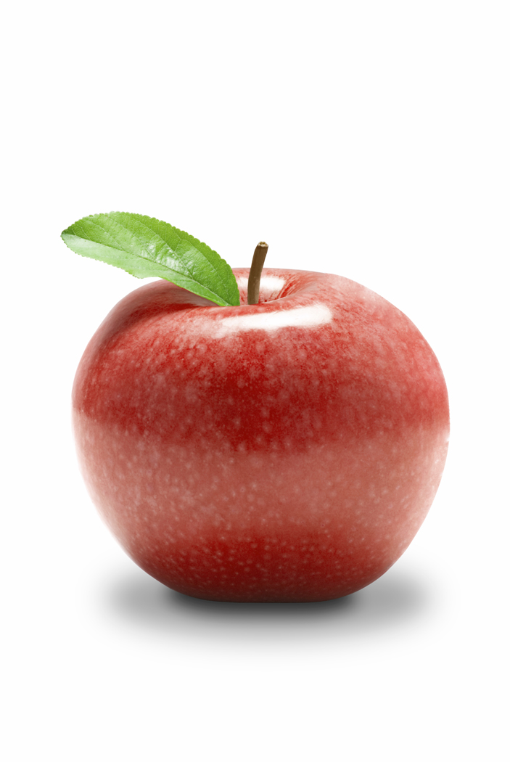
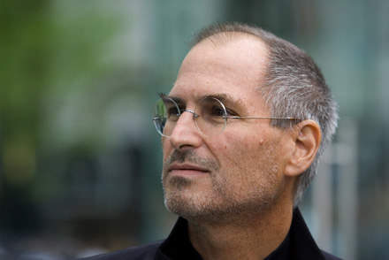
Who is this?

Slide 3
Who is Steve Jobs?
CEO of what companies?
  Apple
  PIXAR
What products did he help create?
  Mac
  Ipod
  Ipad
  Iphone

Slide 4
What is a commencement speech?
A commencement speech is a speech given to graduating students. It is typically given by a notable figure in the community when students receive their degrees.
The person giving the speech is known as the commencement speaker. Very commonly, colleges or university will invite politicians, important citizens or other noted speakers to come and address the graduating class.

Slide 5
Literary Elements
What are literary elements?
  Literary elements are specific characteristics of a text.
  Examples: Theme, Conflict, Characterization, Symbolism, Setting, Tone, Irony

Slide 6
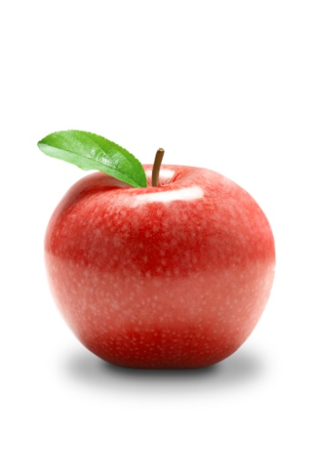
Listening Part I
Now let’s listen to the first part of Steve Jobs’ commencement speech.
What three literary devices does he use?

Slide 7
Literary Devices –Part I
Flashback
Irony
Theme

Slide 8
Figurative Language
What is figurative language?
  language that uses words or expressions with a meaning that is different from the literal interpretation
  Examples: Simile, Metaphor, Alliteration, Personification, Hyperbole, Onomatopoeia, Symbolism

Slide 9
Literary Devices II
What figurative language does Jobs use in this second half of the speech?

Slide 10
Part II – Figurative Language
Metaphors- “I had dropped the baton as it was being passed to me” “It was awful tasting medicine.”

Slide 11
Theme
What is theme?
  The central topic, subject or concept the author is trying to point out.
What is the theme of Steve Jobs’ third story?

Slide 12
The Theme=Main Idea
Stay Hungry: Don’t be too easily satisfied or grow to comfortable.
Stay Foolish: Don’t think that you know everything…Stay foolish and keep learning new things.

Slide 13
Written Response
In your opinion, what does Steve Jobs mean by quoting the statement, “Stay Hungry. Say Foolish?”

